Slide 1
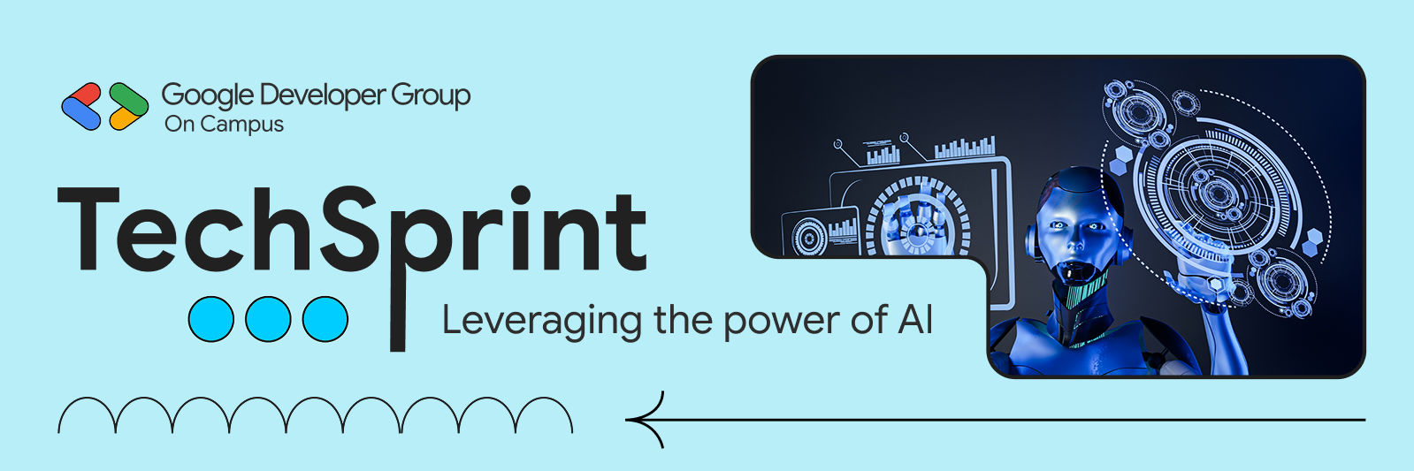
Team Details
  Team name: THE FOURTH DIMENSION
  Team leader name: KARRI GREESHMA VARSHITHA
  Problem Statement: Open Innovation

Slide 2

Brief about your solution and problem statement addressing
Problem:
Burnout often goes unnoticed until it seriously affects mental health, productivity, and performance—especially among students and professionals.
Solution:
Our system continuously tracks lifestyle and workload indicators such as screen time, sleep patterns, stress levels, and activity data to detect early signs of burnout.
Impact:
By generating timely alerts and preventive suggestions, the solution enables early intervention, helping users maintain well-being, balance, and sustained productivity.

Slide 3
Opportunities
  a.How different is it from any of the other existing ideas?
  • Focuses on early prediction, not post-burnout analysis
  • Lightweight, privacy-friendly, and student-centric
  • Combines technology + mental well-being in a proactive way
  b. How will it be able to solve the problem?
  • Continuously monitors burnout indicators
  • Detects risk patterns using smart thresholds
  • Encourages preventive action, not just awareness

Slide 4
List of features offered by the solution
• Continuous monitoring of burnout indicators
• Early risk detection & predictive alerts
• Personalized preventive suggestions
• Simple, user-friendly dashboard
• Privacy-focused data handling
Google Technologies used in the solution
• Google Fit API - activity & health data
• Google forms-used for daily user input
• Google Cloud Platform - data processing & storage
• Google Alerts – used for high risk notifications
• Google Charts – visual analytics & insights

Slide 5
Process flow diagram or Use-case diagram
User Registration & Consent
⬇️
Data Collection
(Screen time, sleep patterns, activity levels, workload)
⬇️
Data Analysis
(Threshold-based logic / basic ML model)
⬇️
Burnout Risk Detection
(Low / Medium / High risk classification)
⬇️
Alert & Notification
(Early warning sent to user)
⬇️
Preventive Suggestions
(Rest, break reminders, lifestyle tips)
⬇️
Continuous Monitoring

Slide 6
Wireframes/Mock diagrams of the proposed solution
2. Dashboard Screen
• Burnout Risk Status: Low / Medium / High
• Key indicators: Sleep, Screen Time, Stress, Activity
• Simple visual bars / icon
Login & Consent Screen
User login/sign up
• Data access permission (health & activity data)
4. Alert & Recommendation Screen
• Early warning notification.
• Personalized suggestions (rest, breaks, lifestyle tips)
3. Analysis Screen
• Trend view of daily activity & stress
• Burnout score calculation
• Risk pattern identification

Slide 7
Architecture diagram of the proposed solution
1.USER APP
(MOBILE/WEB)
2.DATA INPUT
(SLEEP,SCREEN TIME,ACTIVITY)
3.PROCESSING AND ANALYSIS
(LOGIC/ML)
4.CLOUD/DB
(FIREBASE)
5.ALERTS AND SUGGESTIONS

Slide 8
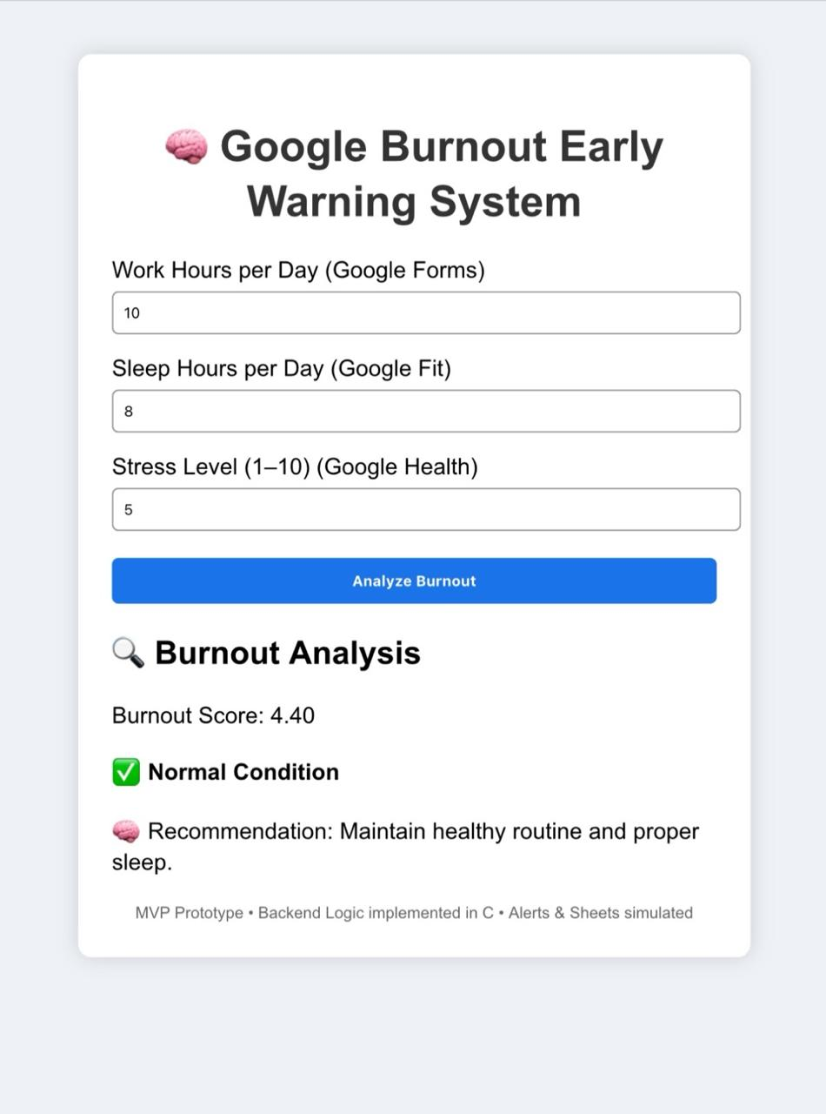
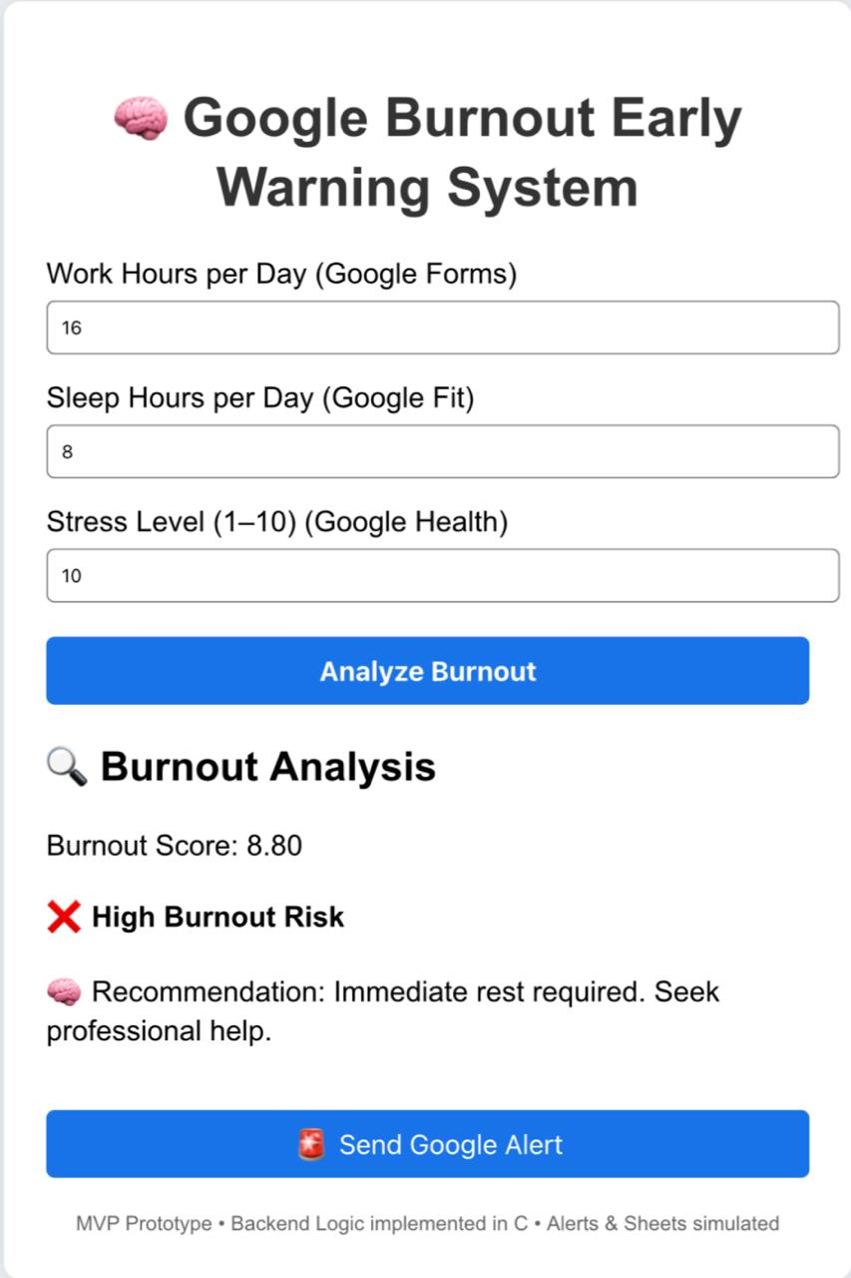
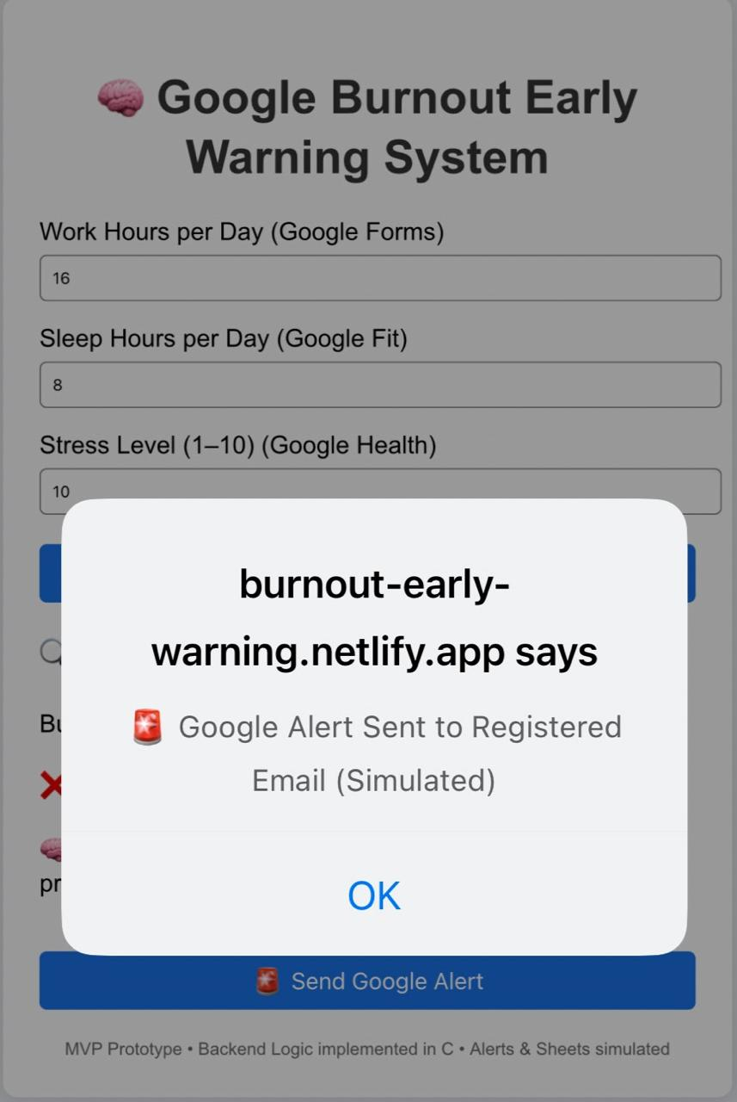
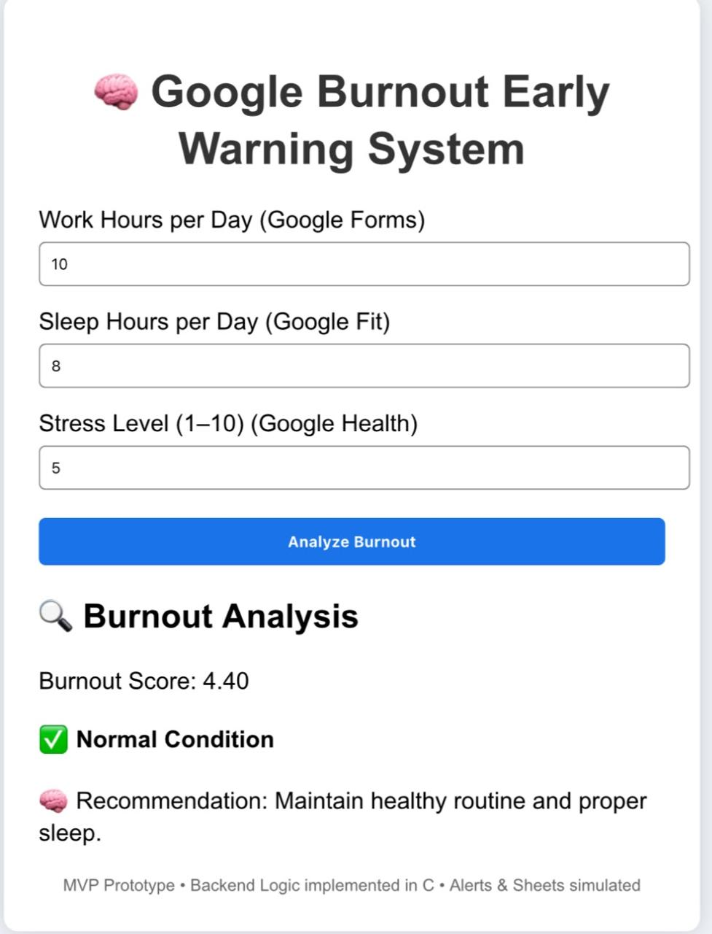
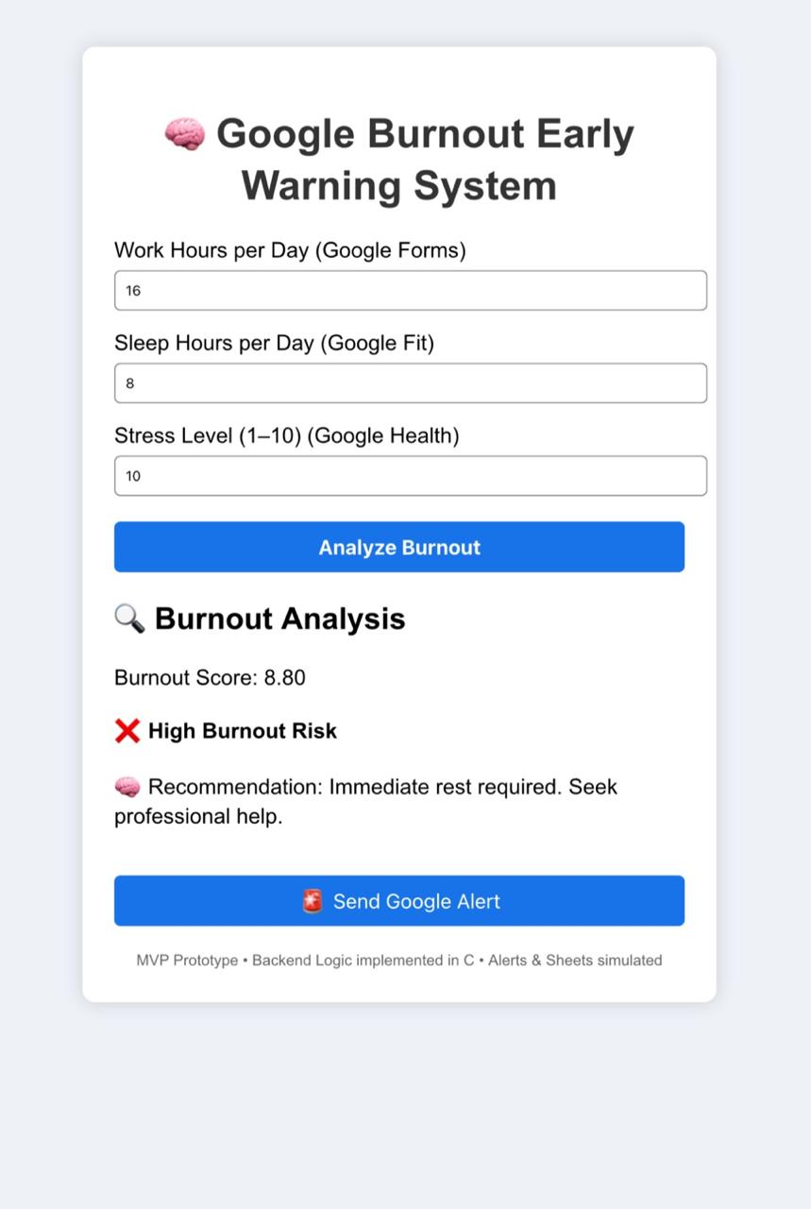
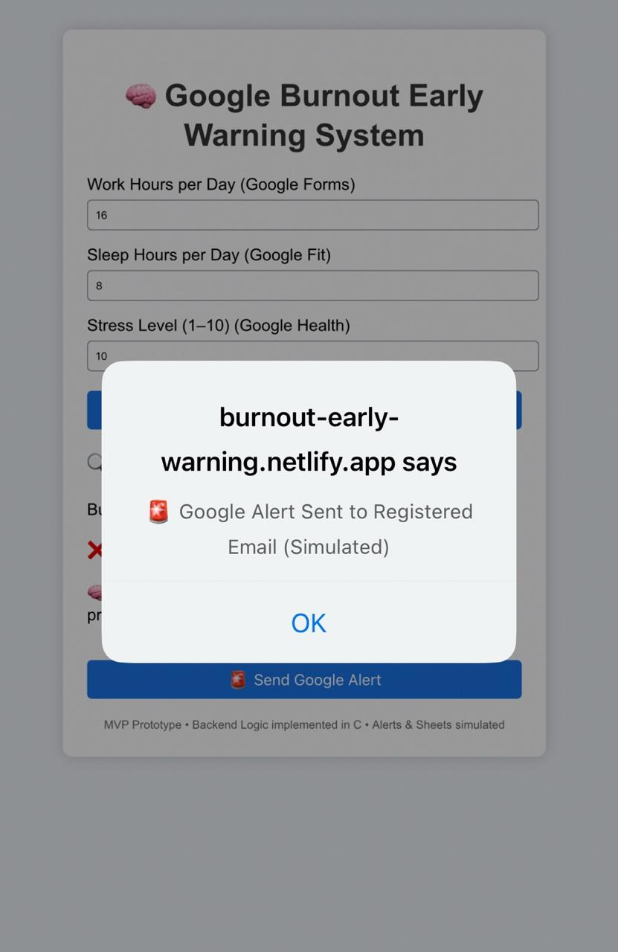
Snapshots of the MVP

Slide 9
Additional Details/Future Development
• Integration with wearables (smartwatch, fitness bands) for real-time data
• Use of advanced AI/ML models for more accurate burnout prediction
• Personalized recommendations based on user behavior trends
• Institution-level dashboards for colleges and organizations
• Multilingual support for wider accessibility
• Stronger data privacy & security enhancements
Provide links to your :
Github Public Repository: https://github.com/orgs/EARLY-WARNING-BURNOUT-SYSTEM/repositories
Demo Video Link (3 Minutes): https://drive.google.com/file/d/1iSLWJG8K5mH0XrwBQVaPUshcoybxzGY1/view?usp=drivesdk
MVP Link: https://burnout-early-warning.netlify.app

Slide 10
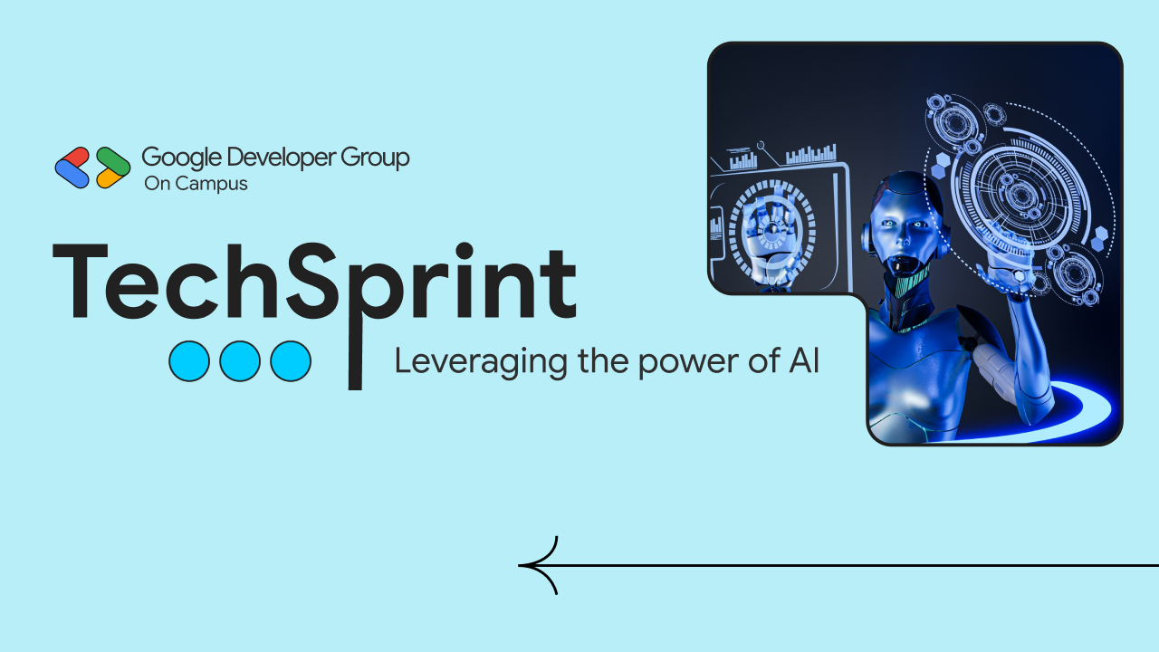
Thank you!

